Slide 1
Raising Boys’ Achievement in secondary schools
Notes:
Image from: https://www.teachingandlearningguru.com/engaging-boys/

Slide 2
‘Boys and Girls Learn Differently’ – Dr Michael Gurian
He believes ”that many poor learners can be turned around if we just acknowledge the differences between boys and girls and re-educate ourselves on how to help them thrive”

Slide 3
Notes:
http://steelturman.typepad.com/photos/uncategorized/mf_brain_1.JPG

Slide 4
Notes:
http://steelturman.typepad.com/photos/uncategorized/mf_brain_1.JPG

Slide 5
Dr Abigail Norfleet Jones – ‘Teaching the male/female brain’
Notes:
https://www.slideshare.net/bgalloway/boys-education-think-win-win-catca

Slide 6
Seeing the world differently
Females | Males
Objects (nouns) | Objects in motion (verbs)
Warm colours (red, yellow, green, orange) | Cool colours (silver, blue, black, grey, brown)
Descriptive | Inventive
Active in class through writing, discussions | Active in class through moving and hands on
Illustrations are highly coloured | Coloured illustrations not important
Female teachers do not move around a lot | Male teachers move around a lot
Female teachers have rich, colourful classrooms | Male teachers see opportunity in energy
Use 3000K lights | Use 4000K lights
Notes:
https://www.slideshare.net/bgalloway/boys-education-think-win-win-catca

Slide 7
Hearing the world differently
Females | Males
Hear better than males | Variety of volume to help boys focus
Interprets loud/deep voices as yelling | Loud talk is not uncommon
Teachers need to be calm and patient when talking to girls | Teachers need to vary their volume when talking to boys
Keep noise distraction to a minimum | Accept tapping (use squish toys)
Sit girls in the middle or back of the room | Sit boys front and center of the room
Notes:
https://www.slideshare.net/bgalloway/boys-education-think-win-win-catca

Slide 8
Engaging the world differently
💍
Females | Males
Brain remains alert while seated | Brain needs movement to stay alert
Brain focuses on verbal activities | Brain focuses on kinesthetic activities
Engaging girls in discovery where they can discover and process with peers | Engage boys energy rather than trying to control it (toss ball to answer questions)
Provide extended periods of time to complete tasks (lots of time to answer questions) | Boys respond better to time pressures and competitions (less wait time for boys)
Give full directions and answer questions before working | Give brief directions and have students start working immediately
Female students sit and work with others | Allow standing when taking notes
Prefer warmer rooms (75 degrees) | Prefer cooler rooms (69 degrees)
Encourage risk taking with girls | Boys love choice
Seat girls face to face | Sit boys side by side (less conflict)
Stress decreases blood flow to brain | Stress increases blood flow to brain
Notes:
https://www.slideshare.net/bgalloway/boys-education-think-win-win-catca

Slide 9
Useful reading
http://webarchive.nationalarchives.gov.uk/20141107071708/https://www.ofsted.gov.uk/sites/default/files/documents/surveys-and-good-practice/b/Boys%27%20achievement%20in%20secondary%20schools%20%28PDF%20format%29.pdf
http://webarchive.nationalarchives.gov.uk/20141107070436/http://www.ofsted.gov.uk/resources/boys-achievement-secondary-schools

Slide 10
Strategies for the classroom
Classroom leaders
Speeding tickets
The margin
Live marking/instant feedback
Questioning props
Role Play
Classroom Environment
Around the room activities
Around the room resources
Seating plans
Choice style tasks
Time pressures/competitions
Task transitions/instructions

Slide 11
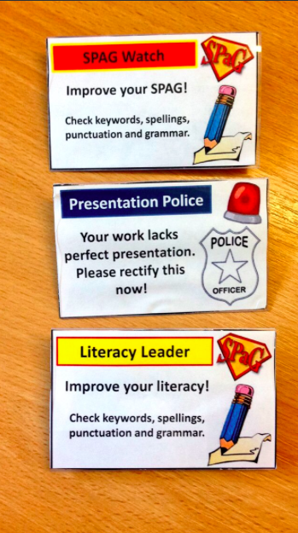
1. Classroom leaders
Give targeted boys opportunities for leadership in the classroom
Presentation Police – students to review peers books and comment on their presentation, giving opportunities to improve
SPAG watch/literacy leaders – students peer review another students use of paragraphs, punctuation, key words, spellings etc.
Templates can be downloaded from here: https://www.tes.com/teaching-resource/literacy-leader-spag-watch-presentation-police-and-speeding-tickets-11305755
Plastic badges can be purchased from here: http://www.wilko.com/sticky-notes+memo-pads/wilko-plastic-badges/invt/0434053

Slide 12
2. Speeding tickets
Boys tend to rush their work, resulting in either lack of precision/detail or poor presentation
As students are working, targeted students are issued a ‘speeding ticket’. This acts as a reminder to take time in their work.
Students are then asked to complete the task with more detail or better presentation – as a form of direct teacher feedback.
Templates can be downloaded from here: https://www.tes.com/teaching-resource/literacy-leader-spag-watch-presentation-police-and-speeding-tickets-11305755
Inspired by: https://lovetoteach87.com/2016/05/31/speeding-tickets-in-the-classroom/
Book version: https://www.tes.com/teaching-resource/literacy-speeding-ticket-11317997

Slide 13
3. The margin
When circulating the room, it is clear to see which boys are working slower than others
Strategy 1: Mark in the margin with a simple dot where the student has gotten up to. Explain to the student you will review their work in 5 minutes time and would like to see/hear what they have done since. The dot acts like an accountability measure. This is inspired by this post: https://www.tes.com/news/school-news/breaking-views/quick-qa-how-ensure-all-your-pupils-work-equally-hard-your-lessons
Strategy 2: Write the time down the margin where you’d expect the student to be up to and by when. These manageable sized chunks act as mini targets for the students.
9:45am
9:55am

Slide 14
4. Live marking/instant feedback
Simple but highly effective strategy - when circulating the room, carry your marking pen with you and mark/give feedback to your targeted students. Boys thrive on instant feedback
Students can then respond to this feedback instantly within the lesson rather than waiting for the next time you see them
Also means more self assessment/student reflection in your books quicker!

Slide 15
5. Questioning props
Throwing a ball to the targeted students to answer questions
Can throw the ball to the next person to answer the next question
Allows boys to be active and use their energy appropriately in the classroom
Allows for random questioning (by peers) and targeted questioning (by teacher)
An alternative is ‘popcorn questioning’ where students call another students name to answer the next question (although this is far less physical)

Slide 16
6. Role Play
Give targeted boys ownership and an opportunity to lead within the classroom
Students have 5-10 minutes to read an information sheet provided by the teacher outside the classroom
They then come back in and present this to to the rest of the class, in character!
Students can then ‘hot seat’ and ask questions to the person in character
This has worked well in history with different historians point of views, and geography acting as different stakeholders.
Decorative props help too!

Slide 17
7. Classroom Environment
Prime learning environments for boys:
Cool colours (silver, blue, black, grey, brown)
Bright lights
Variety of volume to help boys focus
Teachers need to vary their volume when talking to boys
Prefer cooler rooms (69 degrees)

Slide 18
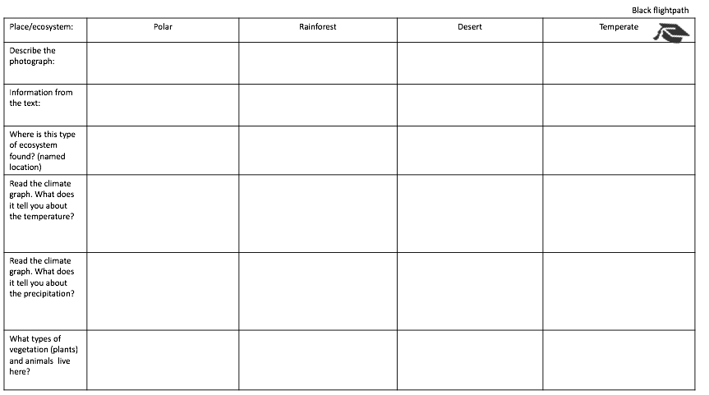
8. Around the room activities
Student led learning in its most simple form comes from around the room activities
Simply give students a table to complete or list of questions to answer, and place the answers/information sheets randomly around the room
Students are given a time limit to complete such tasks
Gives opportunities for boys to be active in the classroom, breaks up learning activities in the room (extended writing for example), and gives boys an opportunity to use their energy appropriately in the classroom.

Slide 19
9. Around the room resources
Similar to the previous strategy, but this time the resources are differentiated
On one side of the room there are ‘stretch and challenge’ resources, and on the other side there are ‘support and recap’ resources
This gives students the opportunity to use whichever set of resources they feel most comfortable with, in a non judgmental way

Slide 20
10. Seating plans
Students should be placed in a boy/girl plan (as proven by research to support learners)
Girls should be seated in the middle or back of the room
Boys should be sat in the front and center of the room
Girls can be sat face to face
Boys should be sat side by side (to avoid conflicts)
Classcharts can do this automatically, and disperse key groups

Slide 21
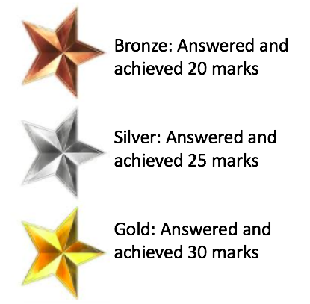
11. Choice style tasks
Give boys choice and autonomy in the activities they’re doing
Tasks can be differentiated by:
Red, orange, green questions
Tricky, Trickier, Trickiest activities
Graded/leveled tiers
Must, should, could
All, most, some
Bronze, silver, gold
A or B

Slide 22
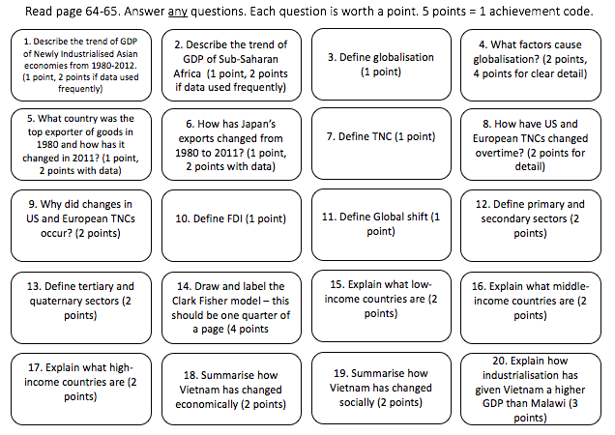
12. Time pressures/competitions
Motivation through competition/rewards
Students select what questions they want to answer
Points = achievement codes
Timers also work well – visually on the board and verbally from the teacher (“5 minutes left…)

Slide 23
13. Task transitions/instructions
Girls prefer full directions and answering questions before working
Boys prefer brief directions. Students could start working immediately after instructions are given – so why not plan for it?

